Slide 1
Speech recognition using hidden markov model
By:
Rahul Kumar Yadav
Prince Roshan
Nihal Babu
Ankit Bhaira
Rohit kumar

Slide 2
Content
What is Speech Recognition?
Voice Recognition?
Process from Speech Production to Speech Perception
How Speech is Represented
Models of Speech Recognition
Types of Speech Recognition
Hidden Markov Model
Why HMM used in Speech Recognition
Three Basic Problems of HMM

Slide 3
Voice Recognition
Aimed towards identifying the person who is speaking
How it works
Every individual has unique pattern of speech due to their anatomy and behavioral patterns
Speaker verification vs. Speaker identification

Slide 4
Speech Recognition
Also known as Automatic Speech Recognition or Computer Speech Recognition
Translation of spoken words into text
Speaker Independent
Speaker Dependent
Performance of speech:
Accuracy
Speed
Problem?

Slide 5
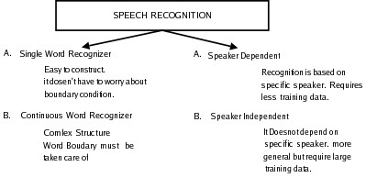
Speech Recognition : Speech recognition is a process of converting speech signal to a sequence of word. Various approach has been used for speech recognition which include Dynamic programming and Neural Network.

Slide 6
Speech Recognition Applications:
Voice User Interfaces
Call Routing
Domestic Appliance Control
Search
Simple Data Entry
Radiology Report
Speech-to-text Processing
Aircrafts

Slide 7
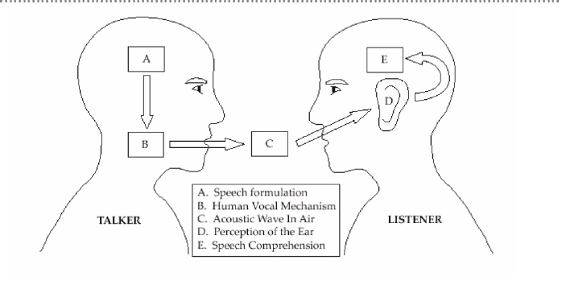
Diagram of the Speech Production/Perception Process

Slide 8
Speech Representation
Speech signal represented in two different domains: time and the frequency domain
Three speech representations:
Able to use speech signal and interpret its characteristics
Three-state Representation
Spectral Representation
Parameterization of the Spectral Activity
Useful to label the speech waveform being analyzed in a linguistic sense

Slide 9
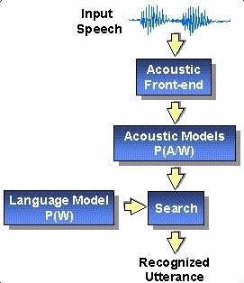
Basic Model of Speech Recognition
This is a diagram of the recognition process
Standard Approach
P(W,Y)
Goal:
Decode string

Slide 10
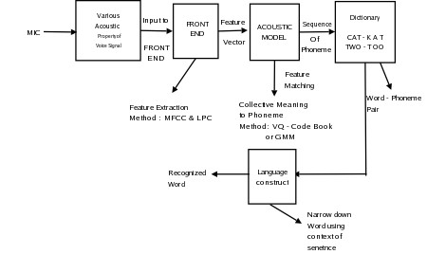
Block Diagram Of Speech Recognition

Slide 11
Types of Speech Recognition
Different classes based on types of utterances they are able to recognize
1. Isolated Words
“Listen/Not-Listen” states
2. Connected Words
“run-together”
3. Continuous Speech
Natural speech
4. Spontaneous Speech
“ums”, “ahs”, stutter

Slide 12
Approaches to Speech Recognition
3 different approaches:
1. Acoustic Phonetic Approach
2. Pattern Recognition Approach
HMM
3. Artificial Intelligence Approach

Slide 13
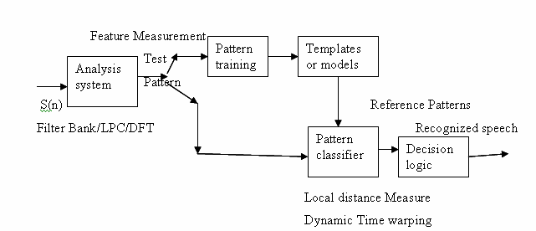
Pattern Recognition Approach
2 steps:
Pattern Training
Pattern Comparison
Uses mathematical framework
Forms:
Speech Template
Statistical Model (HMM)
Goal to determine identity of unknown speech according to how well patterns match

Slide 14
Methods in Pattern Comparison Approach
Template Based Approach
Patterns stored as dictionary of words
Match unknown utterance with reference templates
Select best matching pattern
Stochastic Approach (HMM)
Probabilistic Models
Uncertainty and Incompleteness

Slide 15
HMM
HMM is used in the technique to implement speech recognition systems
Characterized by finite state Markov Model and set of output distributions
Doubly stochastic
Underlying stochastic process which is not observable

Slide 16
The “Hidden” Part of the Model
System being modeled is assumed to be a Markov process with unobserved states
States not visible
output is visible
Each state has probability distribution
Hidden refers to the state sequence through which model passes

Slide 17
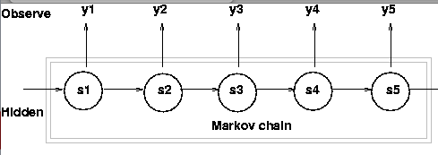

Diagram and Representation of HMM
-Three Probability Densities
-Least important
-Most important

Slide 18
Why HMM’s Used in Speech Recognition
General purpose speech recognition systems are based on HMM
Used because speech signal can be viewed as:
a piecewise stationary signal
short-time stationary signal
Can be trained automatically
Simple
Computationally feasible

Slide 19
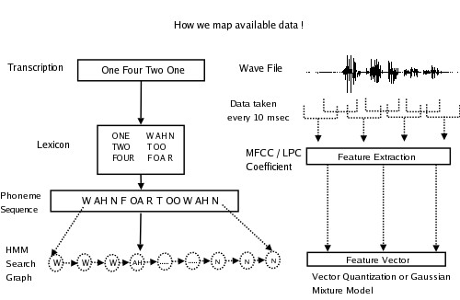
Architecture Of speech recognition

Slide 20
Problems with HMM
Three problems
1. Evaluation Problem
How do we “score” or evaluate the model?
2. Estimation Problem
How do we uncover state sequence?
3. Training Problem
It adapts the model parameters to observed training data → will create the best models for real phenomena

Slide 21
How Solutions to HMM Problems select word:
Example:
How use Problem 3 ( Training Problem)
Get model parameters for each word model
How use Problem 2 ( Estimation Problem)
Understand the physical meaning of the model states
How use Problem 1 (Evaluation Problem)
To recognize an unknown word
Score each word based on given test observation sequence and select word whose model scored the highest

Slide 22
Training:
The most difficult task is to adjust the model parameter to accurately represent the word under consideration. In training mode large amount of voice data ( from different speaker ) is given to HMM model. Using this, HMM adjust its probability distribution and transition matrix. There is no global optimal algorithm for learning. Every HMM must be trained to maximize it’s (local optimum) recognition power. Initially HMM for phoneme (before learning) consists of 3-state and it’s adjacency matrix and output probability distribution are initialized randomly. It gets automatically updated once the training starts.[4] Recognition : unknown word is fed to HMM and it’s output probability is calculated.
Five steps for automatic speech recognition(ASR)
• Feature Extraction: 39 MFCC features
• Acoustic Model: Vector Quantization - Output probability distribution for each state
• Lexicon: Word to Phoneme mapping - Used in creation of HMM
• Language Model: N-grams for computing P(wi |wi−1)
• Decoder: Viterbi algorithm, using dynamic programming for combining all these to get word sequence from speech!

Slide 23
Conclusion
We saw how HMM can be used as signal model for speech recognition application.
Forward, Viterbi and Baum-Welch algorithm provide solution to three problem associated with HMM.
Speech recognition using HMM gives good result due to resemblance between architecture of HMM and varying speech data. Neural Network is another method, which uses gradient decent method with back propagation algorithm.
Study shows that this method works well in presence of large amount of training data also the recognition accuracy is high if the word under consideration is from training data set. While in HMM, the recognition ability is good for unknown word.
HMM is generic concept and is used in many area of research

Slide 24
References
Dan Jurafsky. CS 224S / LINGUIST 181 Speech Recognition and Synthesis. World Wide Web, http://www.stanford.edu/class/cs224s/.
Lawrence R. Rabiner. A Tutorial on Hidden Markov Model and Selected Applicaiton in Speech Recognition. IEEE, 1989.
Willie Walker, Paul Lamere, and Philip Kwok. Sphinx-4: A Flexible Open Source Framework for Speech Recognition. SUN Microsystem, 2004.
Steve Young and Gunnar Evermannl. The HTK Book. Microsoft Corporation, 2005.

